Slide 1
Office of Research Research Development and Support Series Advanced Budgeting for Sponsored Programs
Monday, November 18, 2019 9:30 AM
University Hall 454

Slide 2
Our Experts
Patrick Clark
AVP Operations & Business Intelligence, Office of Research
Sarah Clift
Proposal Development, Office of Research
Cindy Treacy
Assistant Director, Grants Office, College of Arts & Sciences

Slide 3
Experts in your area
Work with Department/College Grant & Business Admins
CEAS: Carol Ross 558-6498
A&S: Cindy Treacy 556-3533
Amy Jones 556-6736
COM: Steve Manning 558-2045
Teresa Larkin 558-3551
CECH: Carole Donnellon 556-5790
John Schwartz 556-1913
CAHS: Pam Quinlisk 558-9515
PHARM: Mary Ann Schaefer 558-0716
CON: Erin Grant 558-2385
COB: Beth Hoff 556-6581
DAAP: Tricia Vonderahe 556-1203
CCM: Steve McConnell 556-6813
Blue Ash: Marc Watson 936-1664
Clermont: Daniel Solazzo 732-5204
OoR RDS: Sarah Clift 558-1417

Slide 4
Agenda
Advanced Budgeting Topics:
Consultants / Collaborators / Subawardees
Student Aid vs Salary and Wages
Cost Sharing
F&A – Rates & Waivers
Treatment of Costs
Common pitfalls
Q&A

Slide 5
Consultants, Collaborators and Subawardees
You may collaborate with others within the University, or colleagues in your network outside of UC
University Employees are always listed in the Personnel section of your budget; they are never Consultants
Non-University employees are never listed in the Personnel section; they may be Collaborators, Consultants, or Subawardees

Slide 6
Consultants, Collaborators, and Subawardees
What are the differences?
Level of involvement in the project
Consultants may be key personnel; Collaborators are always key personnel
Collaborators and Consultants both provide specialized expertise; Co-Investigators generally provide more umbrella expertise
Status with the organization
Consultants must be non-employees; Collaborators may be employees or not
Consultants will usually work on a Personal Service Contract (PSC); Collaborators may be part of a subaward agreement
Use of Institutional Resources
Consultants will usually be individuals on “their own time”; Collaborators will often be using institutional resources that require a subaward agreement

Slide 7
Consultants, Collaborators, and Subawardees
Other notes
Subawards are always made with other organizations; most consultant agreements are made with individuals
Some collaborators may forgo payment and work only for credit, potential publications, etc. They still may be key personnel, even if there is no budget cost
Subawards are exempt from competitive bidding requirements (state/federal). Personal Service Contracts are not; limit is $30,000

Slide 8
Student Aid vs Student Wages
Students may be compensated in many ways for their involvement on a sponsored project
Wages (Student Worker)
Scholarships / Tuition assistance
Stipends / Graduate Assistantships
Payment of or reimbursement for business expenses (travel, etc.) is not compensation
It is essential that, when adding students to a budget, you understand sponsor rules and restrictions and how you wish to treat them under those rules

Slide 9
Student Aid vs Student Wages
Some sponsored projects may specify that money be used only for student aid; in these cases you may not use funds to pay wages (e.g. REUs)
Student Worker: paid wages; based on number of hours worked (clock in/out); paid biweekly; payments may be irregular (more or less hours each period)
Scholarship: student aid, not wages; can be conditional based on academic performance; no tracking of hours “worked”; paid on a semester basis in regular increments
Stipends: student aid, not wages; can be conditional based on performance, but no tracking of hours “worked” as they are aid, and not reimbursement for work; usually paid monthly in regular increments (can be paid on a semester basis)

Slide 10
Student Aid vs Student Wages
Scholarships and Stipends are student aid, they may affect a student’s eligibility for other types of aid – scholarship limits, loan limits, etc.
Wages may also have an effect on student aid
It is the student’s responsibility to understand their aid, restrictions, etc.
It is the PI’s responsibility to inform the student whether they will be employed (Student Worker) or receiving aid (Scholarships/ Stipends)
Hint: If a sponsored program is designed specifically to provide funding for students, it is far more likely to be aid, not wages

Slide 11
Cost Sharing
Cost Sharing is a commitment by the University to pay a portion of the costs of a sponsored project
The University makes a contribution to every project; when that contribution is quantified and tracked, it is a cost share
Cost sharing may be mandatory (required by the sponsor) or voluntary
Voluntary cost sharing is often discouraged by sponsors
Some federal agencies do not allow it
If a sponsor expects cost sharing, they are usually not shy about letting you know!

Slide 12
Cost Sharing
When cost sharing is mandatory, it is important to understand what type of cost sharing are acceptable to the sponsor:
In-kind cost sharing are contributions made from existing materials, space, or initiatives. Could include use of university equipment or other resources, reduced F&A, even money spent on other sponsored programs in some cases
Cash cost sharing is a commitment of funds directly to pay for elements of the project (common with equipment grants, for example)
The university prefers to make in-kind cost sharing commitments over cash commitments

Slide 13
Cost Sharing
If your budget includes cost sharing, you must determine, before you submit, where the cost sharing will come from – and ensure you have approval for the commitment
The Office of Research provides cost sharing support for some projects. A formal request must be made to the VP for Research for this support
Your college dean or your department head may be willing to provide cost sharing support. Specific procedures will vary by area
If you submit a proposal budget that includes cost sharing without prior approval from the source of the commitment, we may not be able to accept the award even if it is funded

Slide 14
F&A – Rates and Waivers
Many opportunities with mandatory cost sharing will require a letter indicating how the University will provide the commitment
These letters will be signed by the VP Research, Provost, or other cognizant authority that is responsible for the commitment, be it in-kind or cash
It is essential that these are recognized, and any necessary documentation completed, as early as possible in the process
Cash commitments are a limited resource; if you have a mandatory cash commitment reach out to the appropriate office at the beginning; last-minute requests will rarely be treated favorably.

Slide 15
F&A – Rates and Waivers
F&A (indirect, overhead) is a rate applied to sponsored programs to cover support costs – facilities (buildings, power, water, etc.) and administrative (compliance, proposal preparation, accounting, etc.)
The University negotiates F&A rates with the federal government every 4 years; formula is based on support costs divided by direct costs
Some non-federal sponsors honor the negotiated rate; some federal projects have special rates
Many foundations and other non-federal sponsors simply pay a single rate
Current negotiated F&A rates: 60.5% (research), 58% (instruction), 30% (other sponsored activity), 26% (any project performed off-campus)

Slide 16
F&A – Rates and Waivers
F&A Rates recover a portion of the costs associated with sponsored programs; they do not generate profit or excess income
For most sponsored projects, F&A is calculated and applied in addition to a fixed direct cost limit
For projects with a total cost cap, an F&A Waiver may be requested if application of an allowable F&A rate limits the ability to perform the necessary work
Waivers are not generally accepted for projects with a direct cost cap only
Notes:
Note top things to look for in an RFP regarding budget:
Limits, both direct & indirect
Restrictions on certain types of expenditures – equipment, faculty salaries, travel, etc.
Mandated expenditures – student support, investigator effort, etc.
Mandated or unallowed cost share
Other?

Slide 17
F&A – Rates and Waivers
Waivers must be applied for during the proposal process, not after the award is issued
You do not need a waiver if:
The sponsor publishes a rate lower than our negotiated rate, or publishes a statement that they do not pay F&A at all
Waivers are usually granted if any of the following are true:
Non-published statement (e.g. email) from sponsor
Limited available funding, and budget constraints can be demonstrated
Pilot project with potential to generate future research
About 100 waivers are submitted each year; almost all are approved

Slide 18
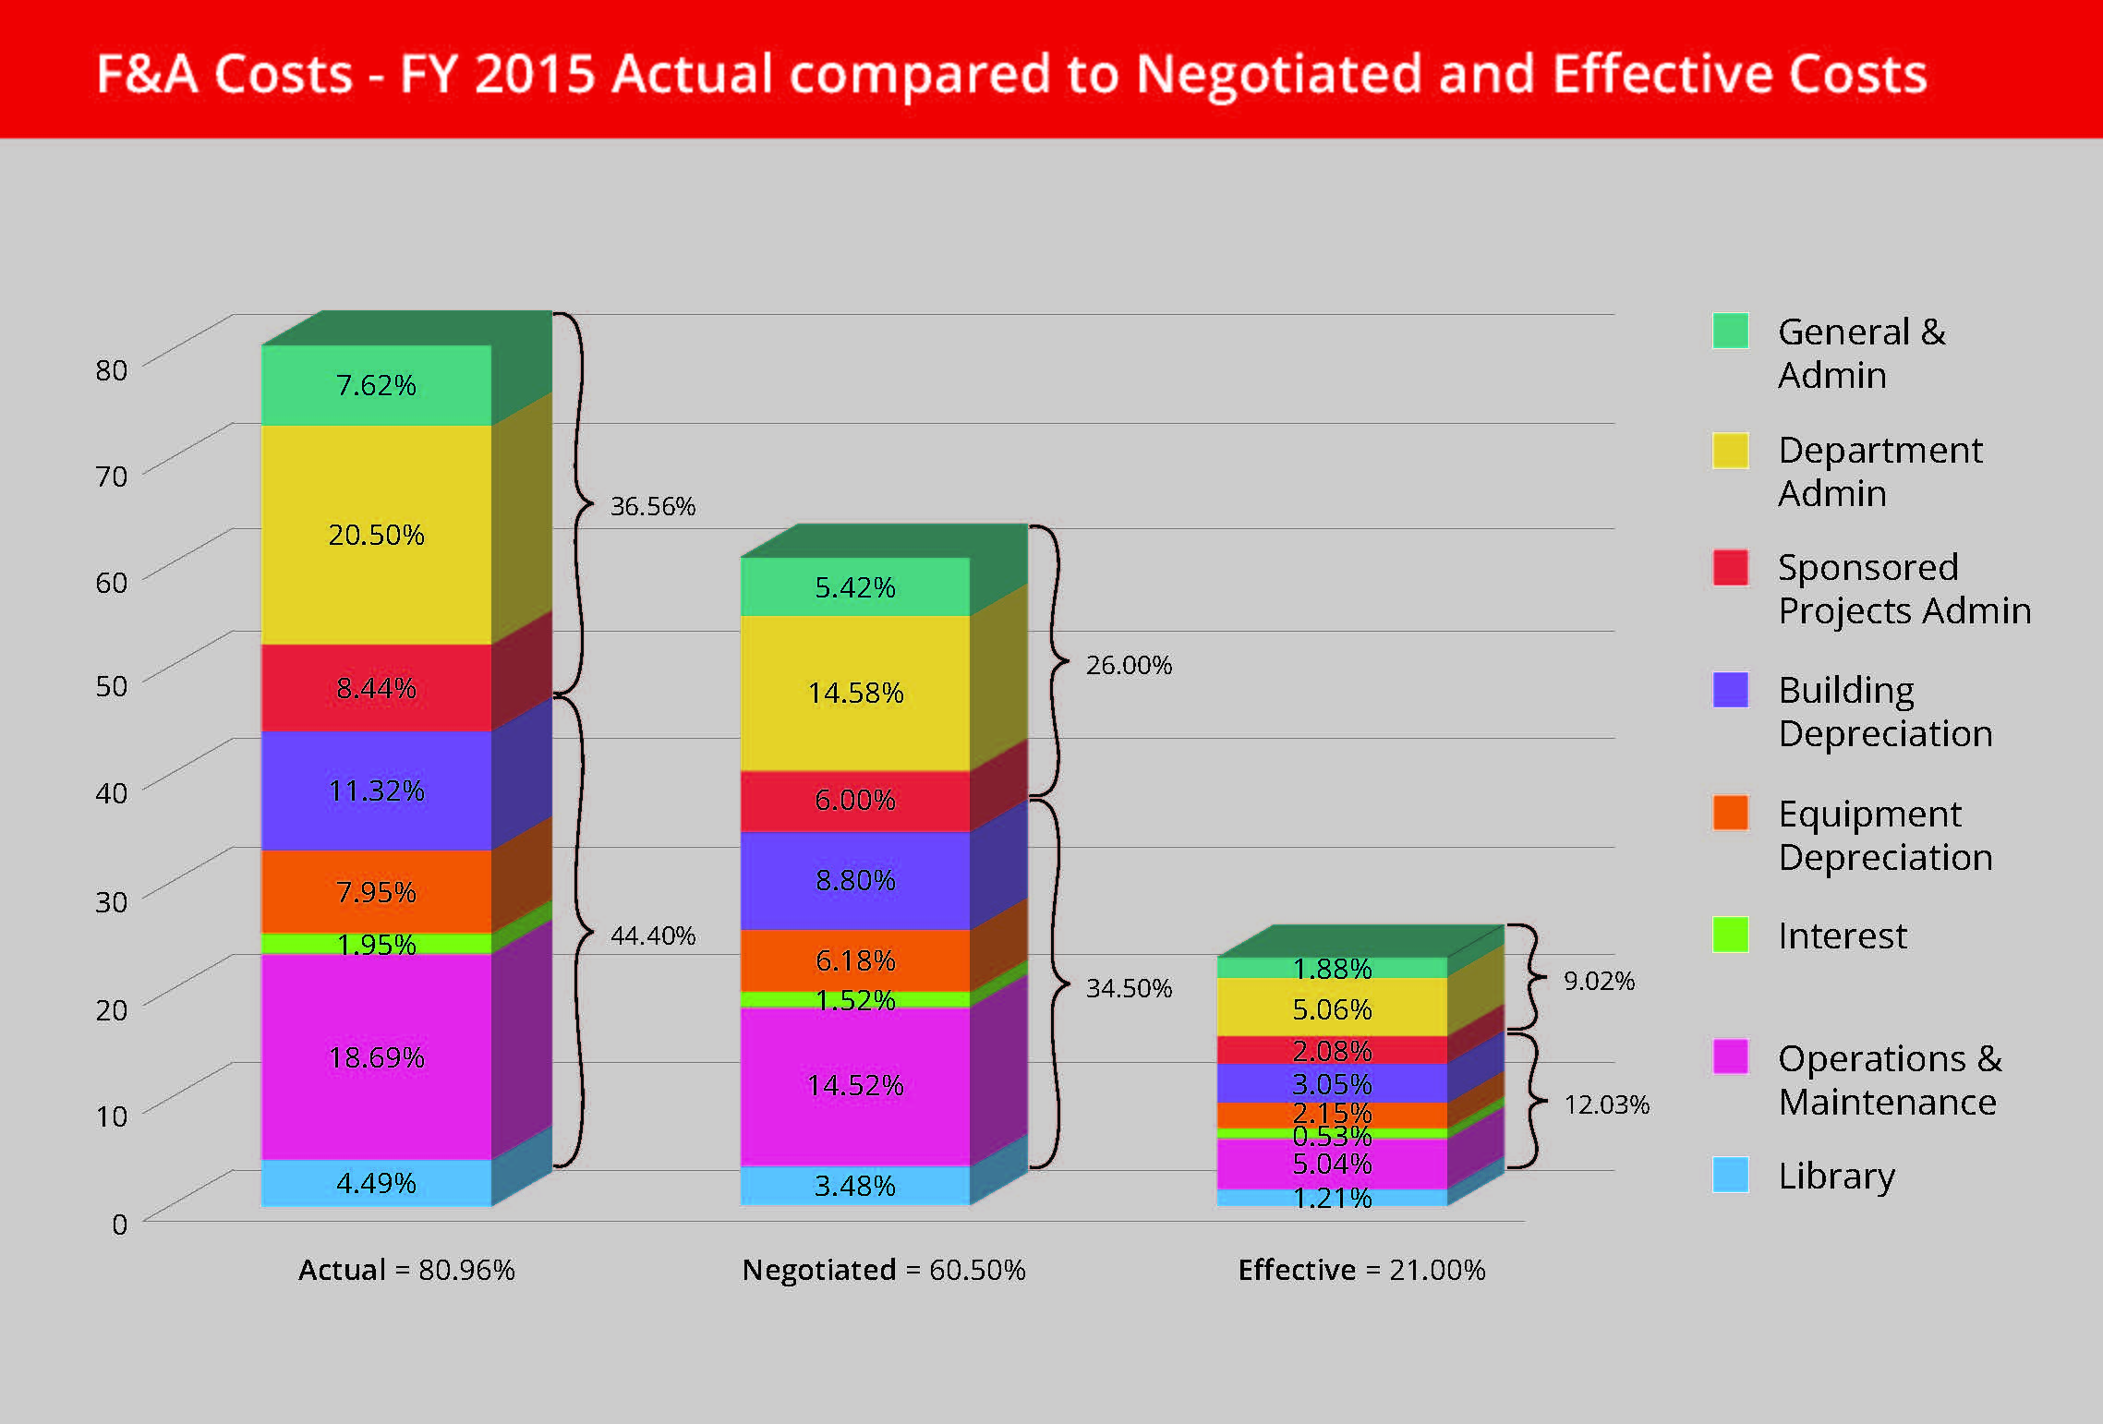
F&A – Rates and Waivers

Slide 19
Treatment of Costs
When preparing a budget, it is essential to keep in mind that any items included in the budget must be allowable, allocable, reasonable, and consistently treated
Allowable – Is this a cost that the sponsor has agreed to pay for? Sponsor guidelines take precedence, but federal rules and laws (both state and federal) may also apply
Allocable – Is this item going to be used specifically for this project? Supplies, travel, equipment, etc. cannot be general purpose
Reasonable – Would a “reasonable person” spend money this way to accomplish the same aim? Buy vs. rent, competitive bidding, etc.
Consistently treated – Like costs must be treated in a like manner

Slide 20
Treatment of Costs
Consistent treatment of costs: what you can and cannot put in a direct cost budget
When preparing a budget, you must be careful to ensure that you do not budget something as a “Direct cost” that would normally be recovered as part of the F&A rate
This could include facility costs, but also certain personnel
Administrative personnel are the trickiest grey area here
Some sponsors may allow certain costs as part of the direct cost budget in lieu of paying F&A (for example, rental of facilities is an F&A cost; a sponsor that does not pay F&A may pay for the rental cost directly)

Slide 21
Common Pitfalls
Capital equipment
Only applies to physical objects with an acquisition cost of at least $5,000 and a useful life of at least 1 year OR
Software with an acquisition cost of at least $100,000 and a useful life of at least 1 year
Components that are essential to the operation of a machine may be capitalized with the main device as a single asset
Capital items do NOT generate F&A; non-capital items (e.g. most computers, lab supplies, etc.) DO generate F&A
Mis categorizing equipment can have negative effects on your budget

Slide 22
Common Pitfalls
Travel
Travel must always be specifically to advance the aims of the project, and must take place during the period of performance of the award
In a recent federal audit, the sole finding against UC involved a travel violation
When budgeting travel, remember that federal laws may impact the cost of travel, particularly international travel
Fly America Act

Slide 23
Common Pitfalls
Competitive bidding
If you budget for purchases above certain dollar thresholds, you may be required to solicit competitive bids or quotes
Quotes/bids are not required during the budget/application process, but may be needed when it is time to purchase, so you need to be prepared
Just because you included an item in the budget does not exempt you from purchasing rules
Current federal “micro-purchase” threshold for UC is $15,000 for purchases and $30,000 for personal service contracts (consultants); subawards are exempt
Most competitive bidding will involve purchase of equipment
Sole Source Justifications can be used if a service or product is only available from a single potential vendor

Slide 24
Office of Research Resources
Office of Research Web Site (research.uc.edu)
Office of Research How2 (researchhow2.uc.edu)
Research Directory (researchdirectory.uc.edu) – Ohio Department of Higher Education – Ohio Innovation Exchange (OIEx)
SPIN (research.uc.edu/funding/spin)
Limited Submissions (via web portal (rsrch-webserver.uc.edu/)) Two types – faculty research nominations and research proposals; Selection process dependent on type.

Slide 25
Office of Research Initiatives
Internal Funding Opportunities
Collaborative Research Advancement Grants Program Track 1: Pilot Teams Track 2: Strategic Teams
Faculty Bridge Program
Science Engineering + Art Design (SE+AD) Advancement Grant
Core Capability Development Grant Program
Core Equipment Grant Program
University Research Council
Creative & Performing Arts Cost Support Program Humanities and Social Sciences Cost Support Program Faculty Research Cost Support Awards Program Graduate Student Stipend and Research Cost Awards for Faculty-Student Collaboration Undergraduate Student Stipend and Research Cost Awards for Faculty-Student Collaboration

Slide 26
Help us improve!

Slide 27
Discussion and Q/A

