Slide 1
Office of Research
Research Development and Support Series
Research Development Support – How to Find Funding Opportunities
Friday, October 4, 2019
Faculty Enrichment Center

Slide 2
Overview
Introductions
External Funding
Limited Submission
SPIN
UC Internal Funding
Provost Office
UC Foundation
Industry Opportunities

Slide 3
Our Expert
Susan Dunlap, UC Foundation Associate Director of Foundations and Corporation Relations
Dr. Keisha Love, Assistant Vice Provost for Academic Personnel, Provost Office
Sarah Clift, Senior Grant Administrator, Office of Research
Dr. Teri Reed, Assistant Vice President, Office of Research

Slide 5
Office of Research Initiatives
Internal Funding Opportunities
Collaborative Research Advancement Grants Program
Track 1: Pilot Teams
Track 2: Strategic Teams
Faculty Bridge Program
Science Engineering + Art Design (SE+AD) Advancement Grant
Core Capability Development Grant Program
Core Equipment Grant Program
University Research Council
  Creative & Performing Arts Cost Support Program
  Humanities and Social Sciences Cost Support Program
  Faculty Research Cost Support Awards Program
  Graduate Student Stipend and Research Cost Awards for Faculty-Student Collaboration
  Undergraduate Student Stipend and Research Cost Awards for Faculty-Student Collaboration

Slide 6

Internal Professional Development
Funding Opportunities
Keisha Love, PhD

Slide 7
What is Professional Development?
The purpose of a faculty development program is to maintain professional competence, and improve the quality of the teaching, research, scholarship, creative work, service and leadership throughout the University by assisting and inspiring Faculty Members to reach their full potential.
Notes:
This is the definition of professional development according to the collective bargaining agreement.

Slide 8

Article 24.6: College Level Funds
$620,000 awarded every year
  Unspent funds are “rolled” to the following year
College review committees
Processes and deadlines vary by college
Application website
Notes:
Every college receives professional development funding from the Office of the Provost based on the number of AAUP represented faculty in the college. Each college has a review committee that awards funds. These awards require the written approval of your department chair. The application deadlines vary by college. Ask your unit head.

Slide 9
College Level Funds: Individual Faculty/Group Faculty Award
$5000 maximum
Max of 2 funded applications/faculty member/academic year
Support learning and development in teaching, research, scholarship, creative work, service and/or leadership
  Conferences
  Events
  Training
  Learning communities or writing development
Notes:
This is the first type of award that is available at the college level.

Slide 10

College Level Funds: Supporting Materials Award
$500 Maximum
Max 1 funded application/faculty member/academic year
Hardware or software that supports professional development in teaching, research, scholarship, creative work, service and/or leadership
Notes:
This is the second award available at the college level.

Slide 11
Strategic Collaborative or Interdisciplinary Faculty Team Projects
Faculty teams (3+ persons) leading projects including, but not limited to, innovation and implementation of University, College, or Academic Unit strategies.
The primary benefit/outcome must be faculty development and the primary beneficiaries must be faculty and the university.
$20,000 max for a maximum of one funded application per team or project per year.
Notes:
This award is provided via the collective bargaining agreement; hence, it will be available annually for the next three years. Need to have faculty from multiple disciplines. This doesn’t necessarily mean different colleges. Deadline was September 27th. An additional call may be offered in the spring if funds remain from the fall call.

Slide 12
Appointed or Elected Faculty Group Project Awards
A group may be an Academic Unit, a Faculty task force or committee, or any appointed or elected group of Faculty whose purpose is to provide professional development to Faculty for teaching, research, scholarship, creative work, service and/or leadership as described in Article 24.1.1-3.
The primary benefit/outcome must be faculty development and the primary beneficiaries must be faculty and the university.
The maximum amount of this type of award is $20,000 for a maximum of one funded application per appointed or elected faculty group per year.
Notes:
This award is provided via the collective bargaining agreement; hence, it will be available annually for the next three years. Deadline 9/27

Slide 13

Thank You

Slide 14
Office of Research Resources
Office of Research Web Site (research.uc.edu)
Office of Research How2 (researchhow2.uc.edu)
Research Directory (researchdirectory.uc.edu) – Ohio Department of Higher Education – Ohio Innovation Exchange (OIEx)
SPIN (research.uc.edu/funding/spin)
Limited Submissions (via web portal (rsrch-webserver.uc.edu/)) Two types – faculty research nominations and research proposals; Selection process dependent on type.
Office of Research Findings Please sign up to receive this monthly newsletter (https://research.us16.list-manage.com/subscribe?u=48c9bcb343e73c93605e53eee&id=6527e50384)

Slide 15
Office of Research Resources – NEW!!
Early Career Funding Opportunities – under Funding on main Office of Research webpage (http://researchhow2.uc.edu/search?indexCatalogue=researchhow2-dev&searchQuery=Early+Career+Funding+Opportunities&wordsMode=0)
Office of Research Annual Report – IMPACT

Slide 16
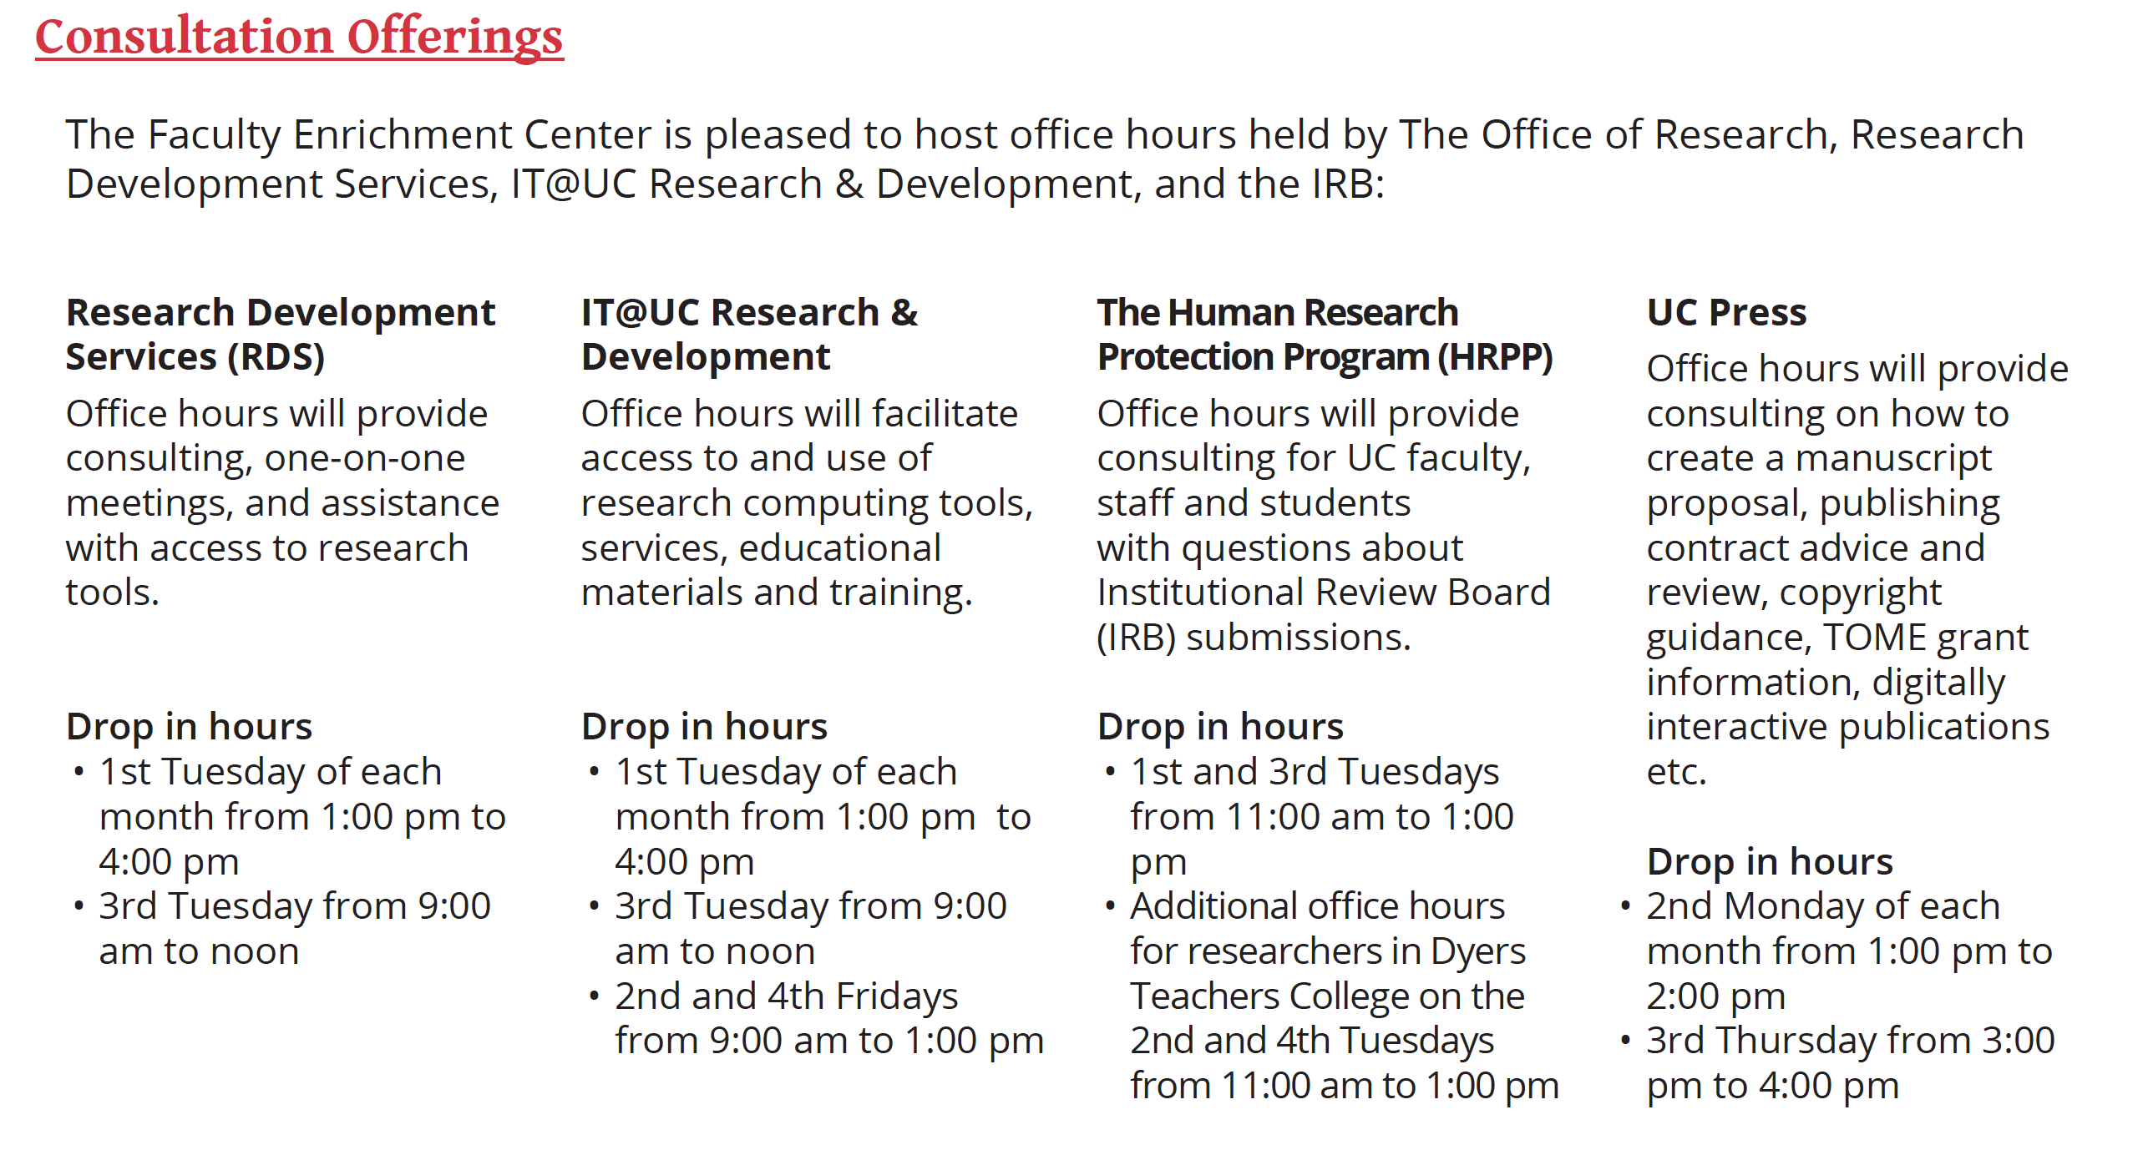

Slide 17
Research Development and Support Series
10/04/2019 – Research Development Support – How to Find Funding Opportunities
11:30am – 1pm, Faculty Enrichment Center, Langsam Library, Room 540F
10/10/2019 – Research Development Support – AtKisson Training Group NIH Workshop
8am – 4pm, Medical Sciences Building, Room E351
10/11/2019 – Research Development Support – AtKisson Training Group NEH Workshop
8am – 4pm, Faculty Enrichment Center, Langsam Library, Room 540F
10/17/2019 – Research Development Support – Internal Funding Opportunities: Learning from Past Recipients
8am – 4pm, Faculty Enrichment Center, Langsam Library, Room 540F
10/23/2019 – Research Development Support – International Research Engagement
11am – 12:30pm, Langsam Library, Room 475
10/29/2019 – Research Development Support – NASA Webinar
1:30pm – 3pm, Faculty Enrichment Center, Langsam Library, Room 540F
Notes:
Please share widely – 13 opportunities starting tomorrow!

Slide 18
Research Development and Support Series
11/04/2019 – Research Development Support – Building Your Research Team: Undergrads, Graduate Students and Postdocs
9:30am – 11am, Faculty Enrichment Center, Langsam Library, Room 540F
11/14/2019 – Research Development Support – UC Infrastructure
3:30pm – 5pm, Langsam Library, Room 462
11/18/2019 – Research Development Support – Advanced Budgeting
9:30am – 11am, University Hall, Room 454
Notes:
Please share widely – 13 opportunities starting tomorrow!

Slide 19

Discussion and Q/A

